Slide 1

Data Description
Session 4
M. Kachour

Slide 2
Numerical summaries of a variable
There are several indicators that summarize the data of a variable:
Position indicators
Dispersion indicators
Form indicators

Slide 3
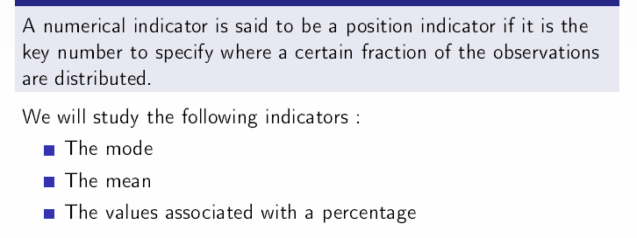
Position indicators

Slide 4
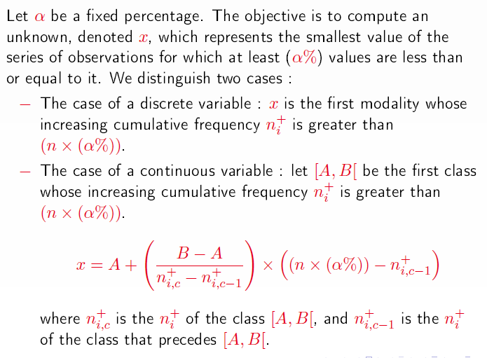
Position indicators – values relating to a percentage
These values can be calculated (using the same technique) when the data are ordinal qualitative variable.

Slide 5
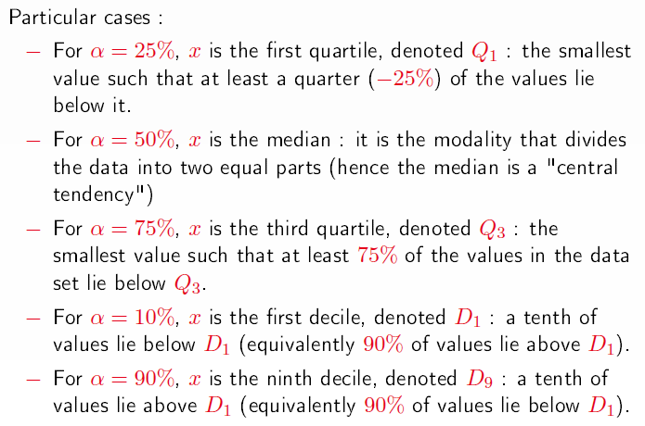







Position indicators – values relating to a percentage
$$q_{1}$$
$$q_{3}$$
$$d_{1}$$
$$d_{1}$$
$$d_{1}$$
$$d_{9}$$
$$d_{9}$$

Slide 6
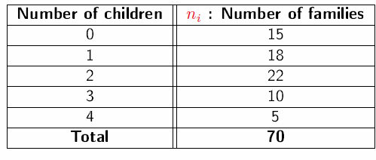
Examples – Calculating Quartiles
Example 1: The data below represent the distribution of 70 families in a village by number of children (under 18 years of age)
Calculate quartiles associated with the data.

Slide 7
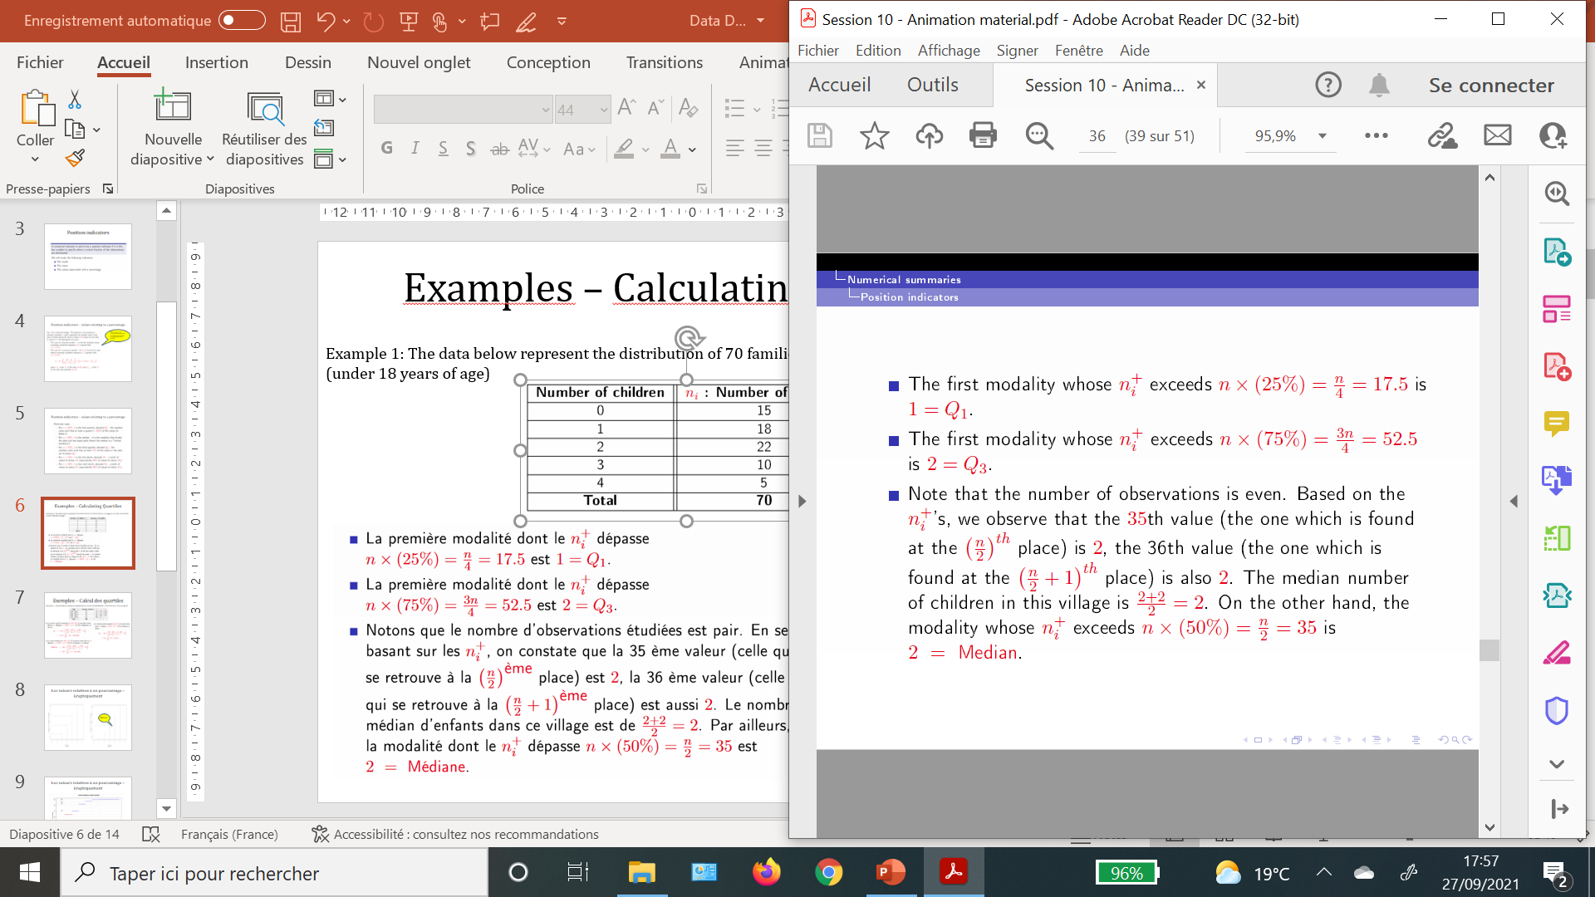
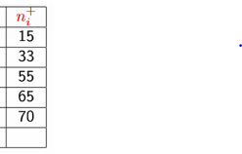
Examples – Calculating Quartiles
Solution:

Slide 8
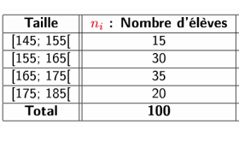
Examples – Calculating Quartiles
Example 2: The data below represents the height of 100 students/sports club members
Calculate quartiles associated with data.

Slide 9
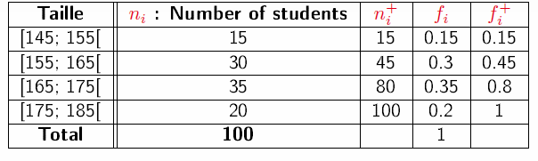
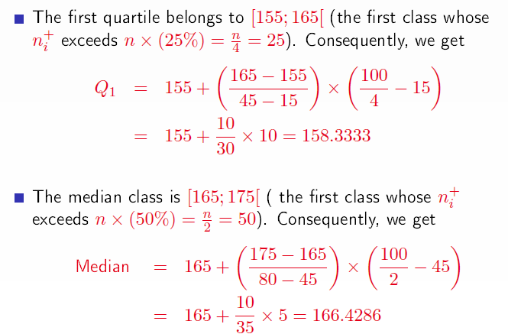
Examples – Calculating Quartiles
Solution:

Slide 10
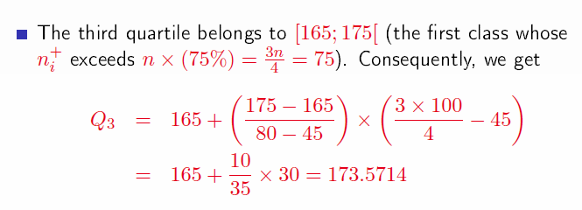
Examples – Calculating Quartiles
Solution:

Slide 11
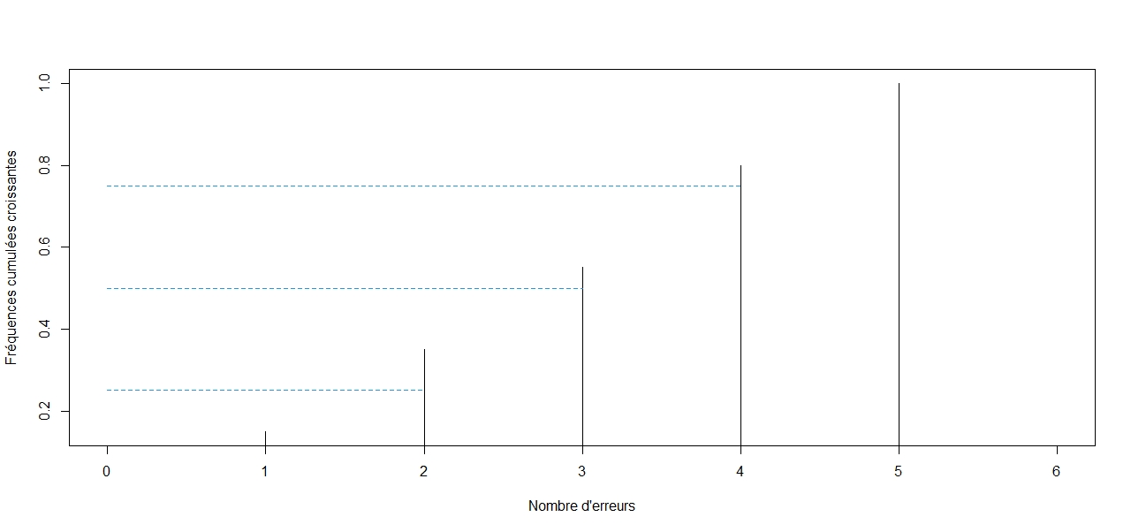
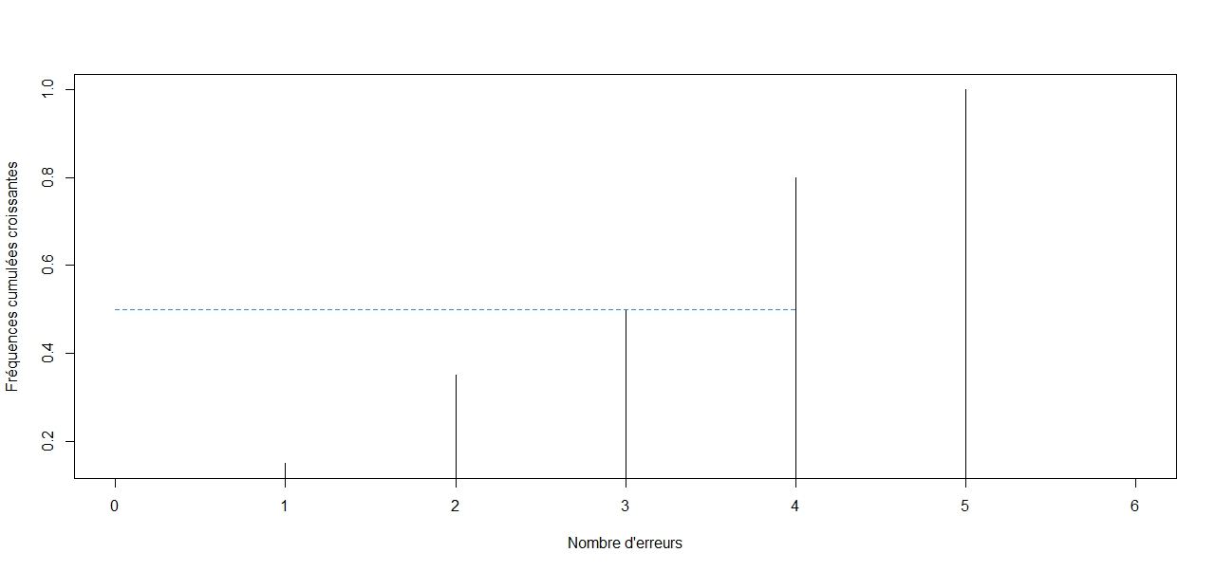
Values relating to a percentage– Graphically
Median

Slide 12
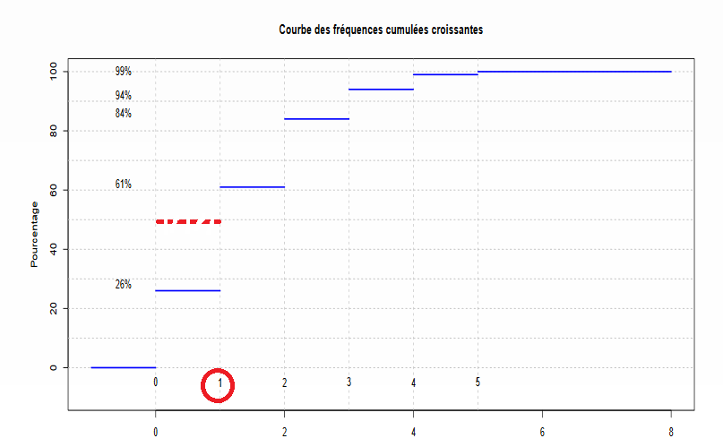
Values relating to a percentage– Graphically

Slide 13
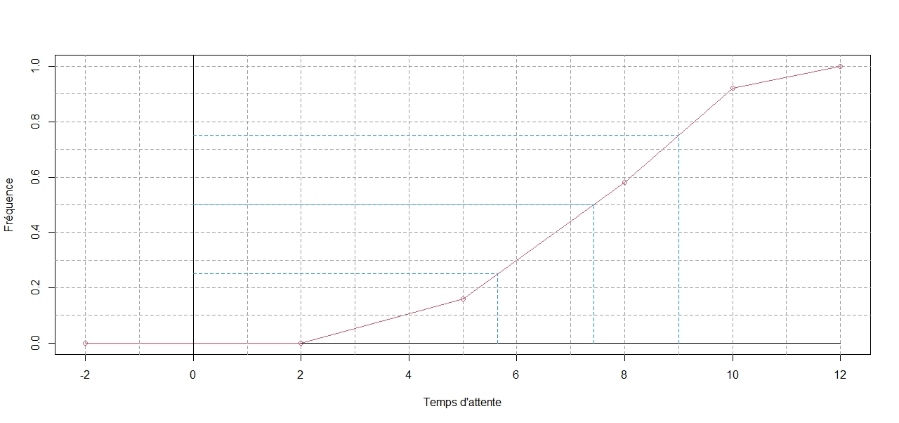
Values relating to a percentage– Graphically

Slide 14
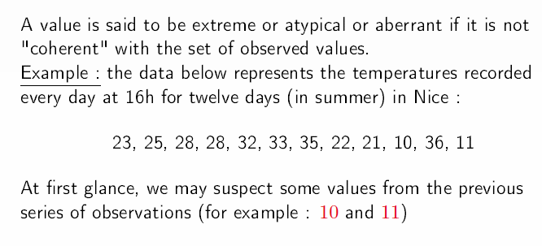
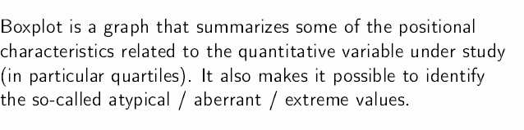
The box plot – detection of the existence of extreme values
This tool is not possible if the data are from a qualitative variable

Slide 15
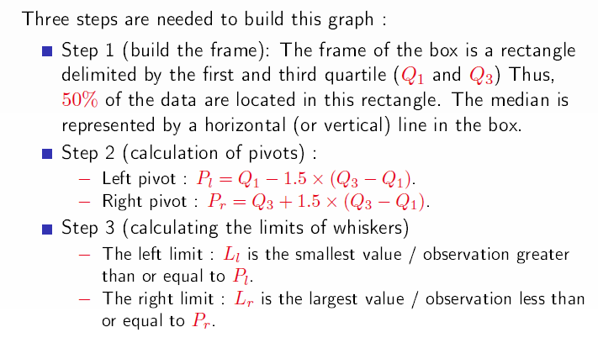
The box plot – construction

Slide 16
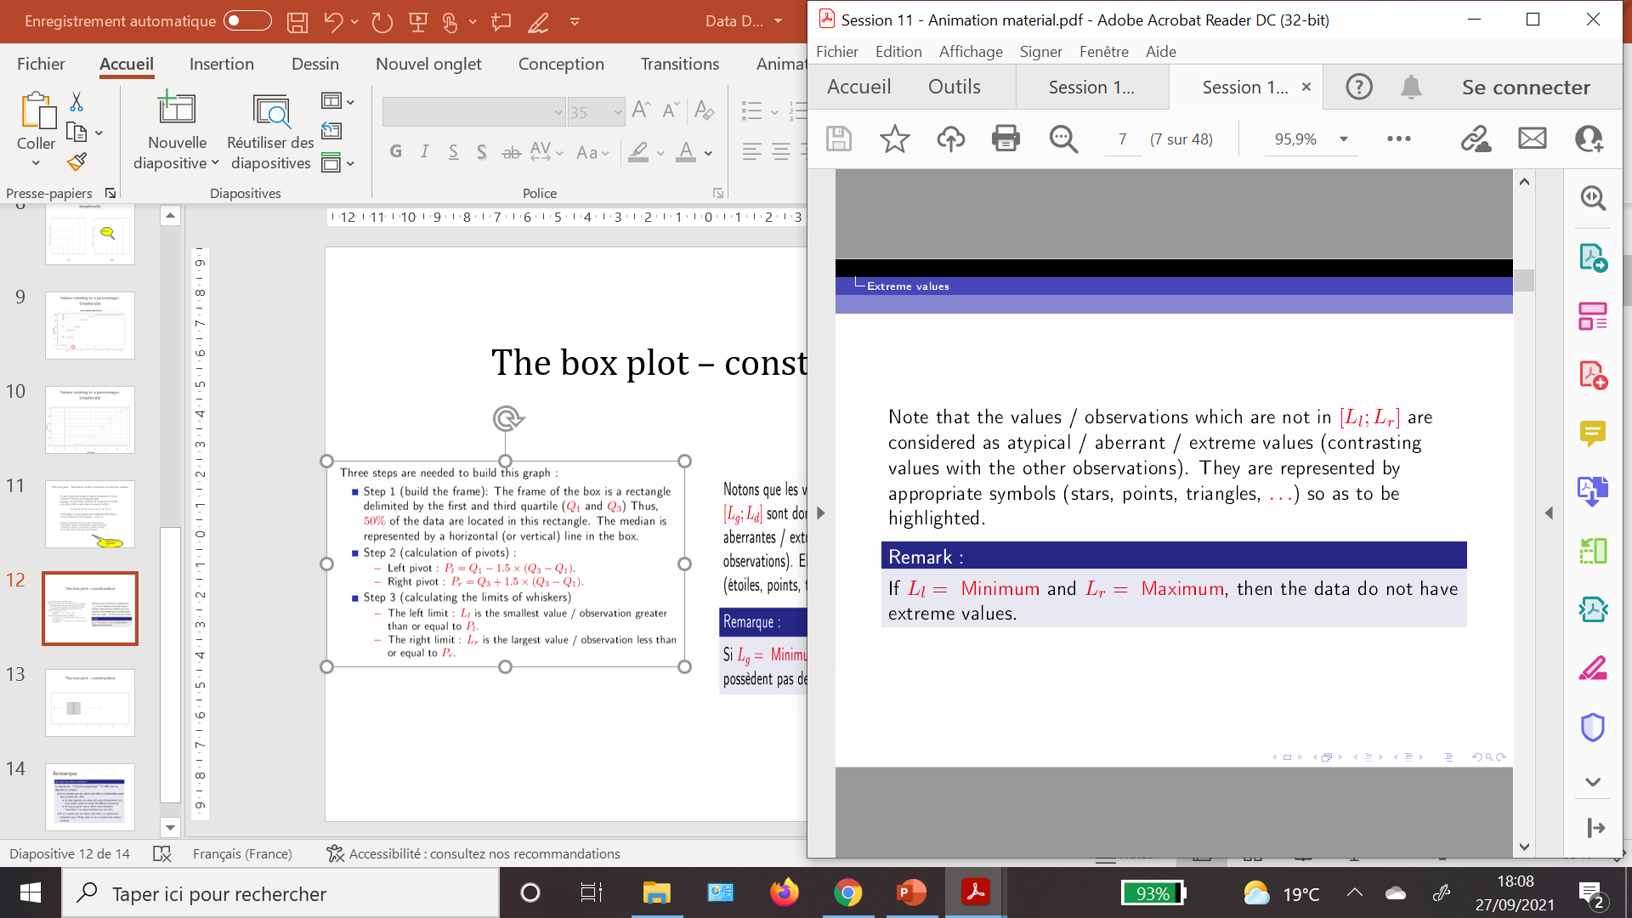
The box plot – construction

Slide 17
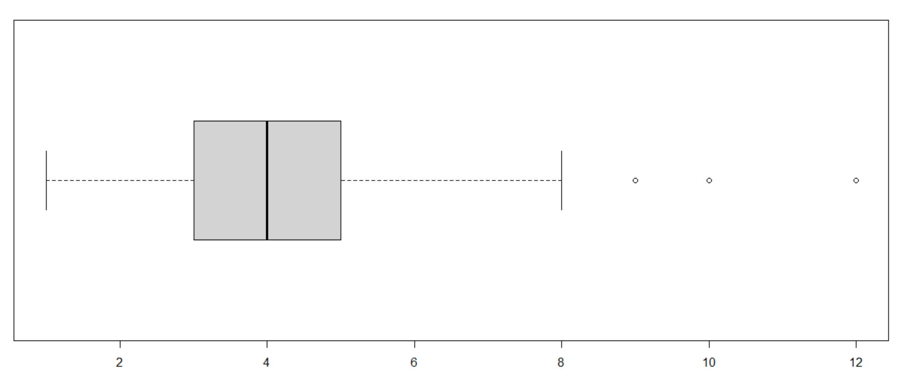
The box plot – construction

Slide 18
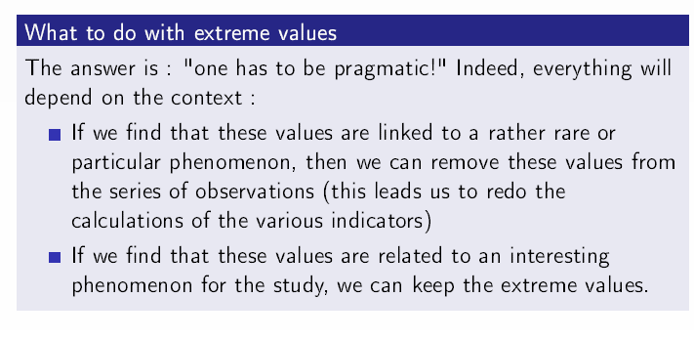
Remark

